Slide 1
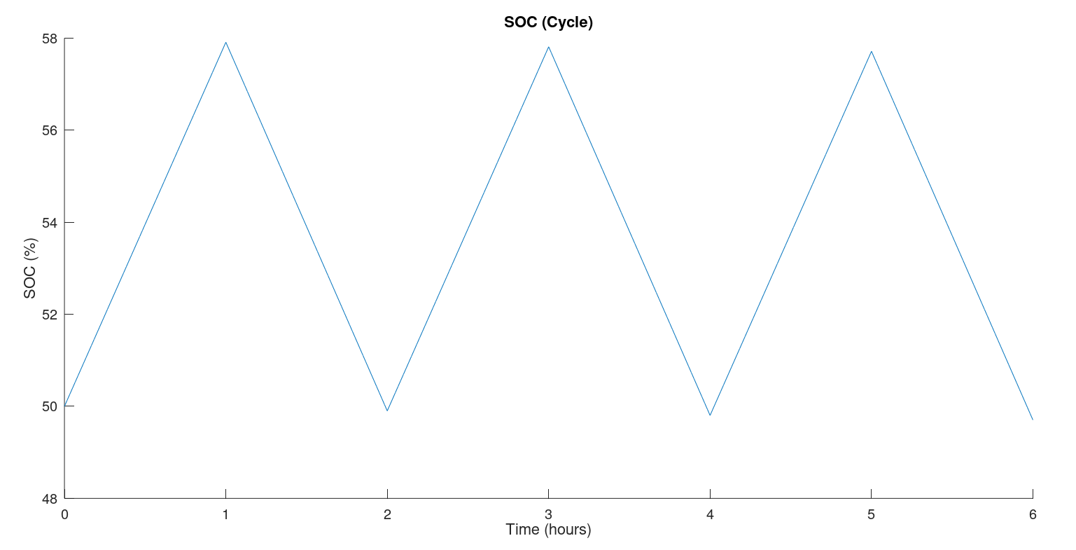
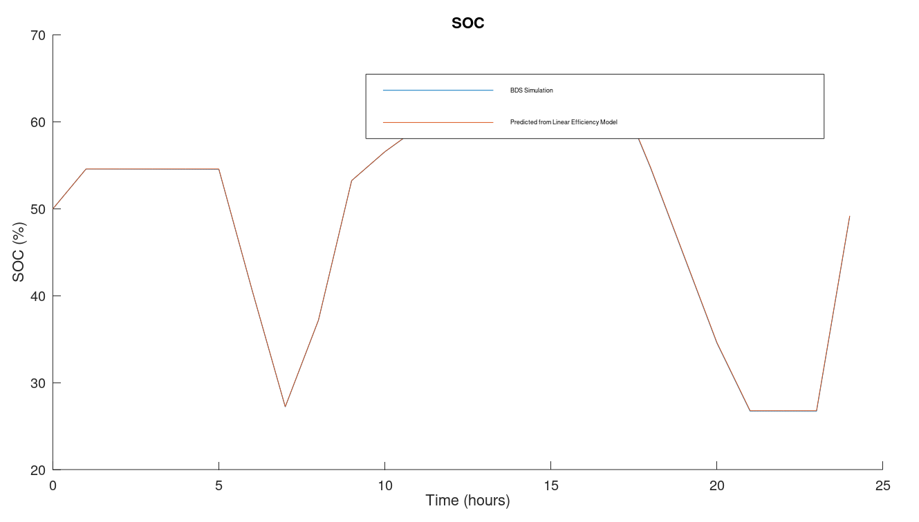
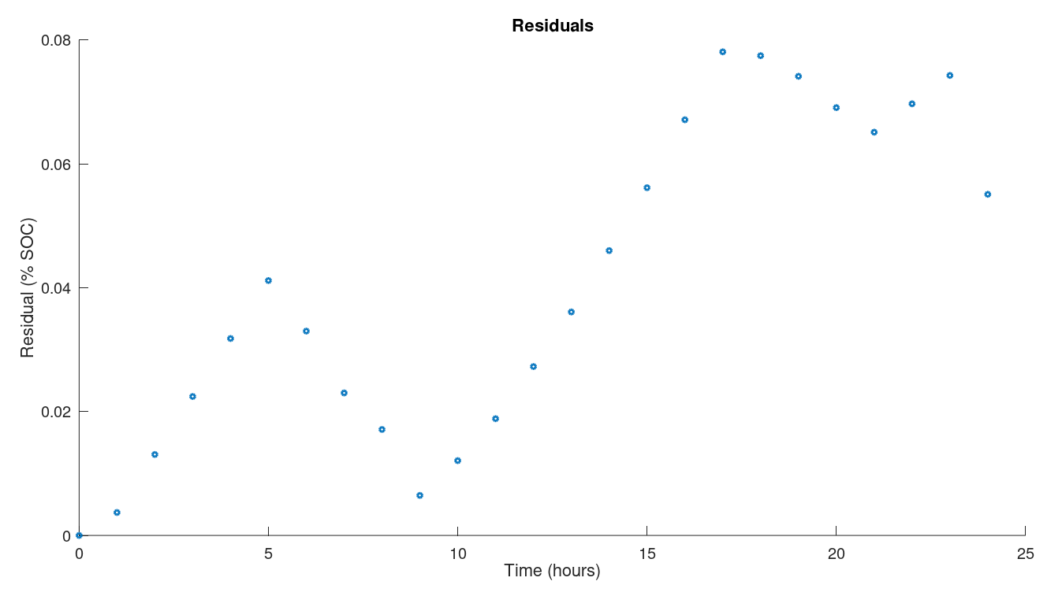
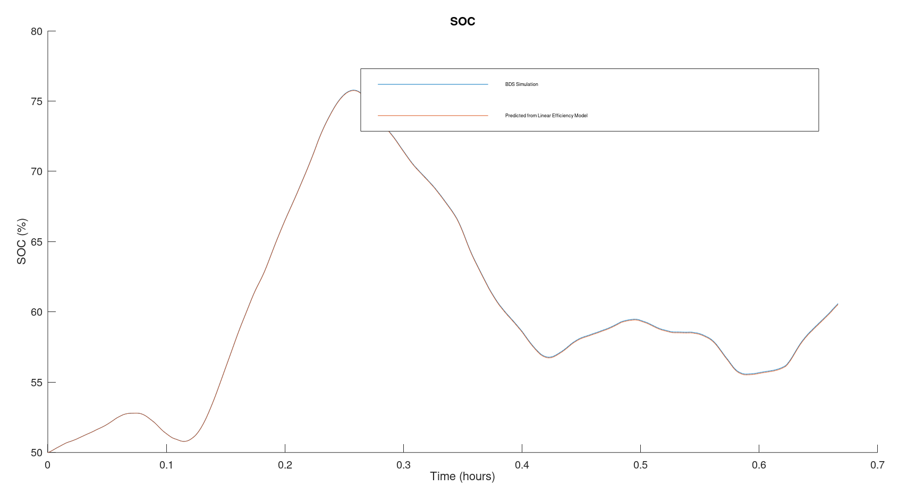
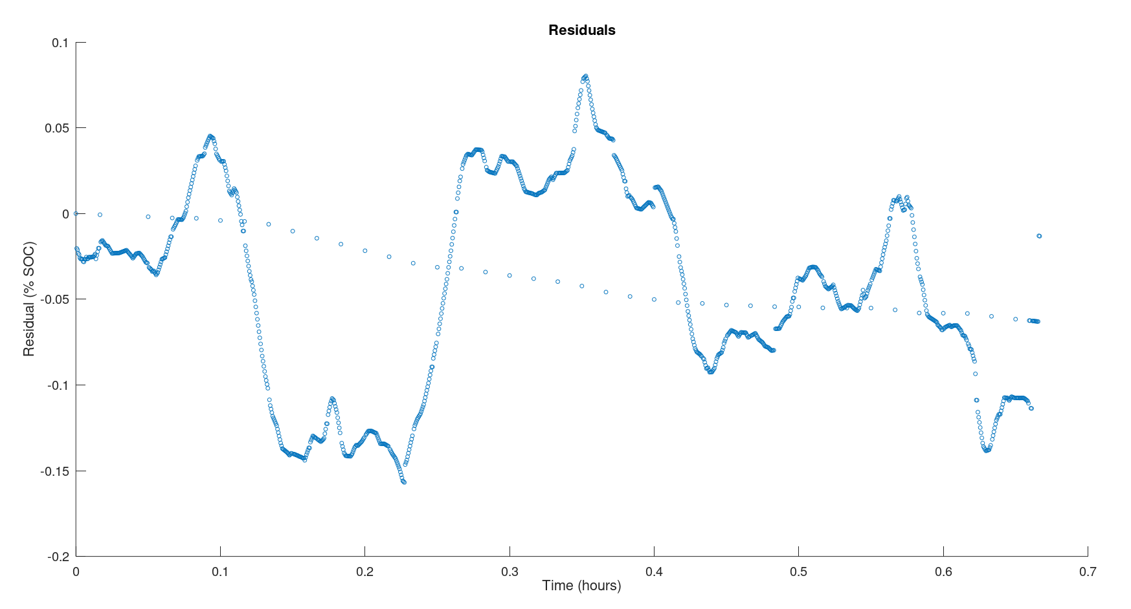
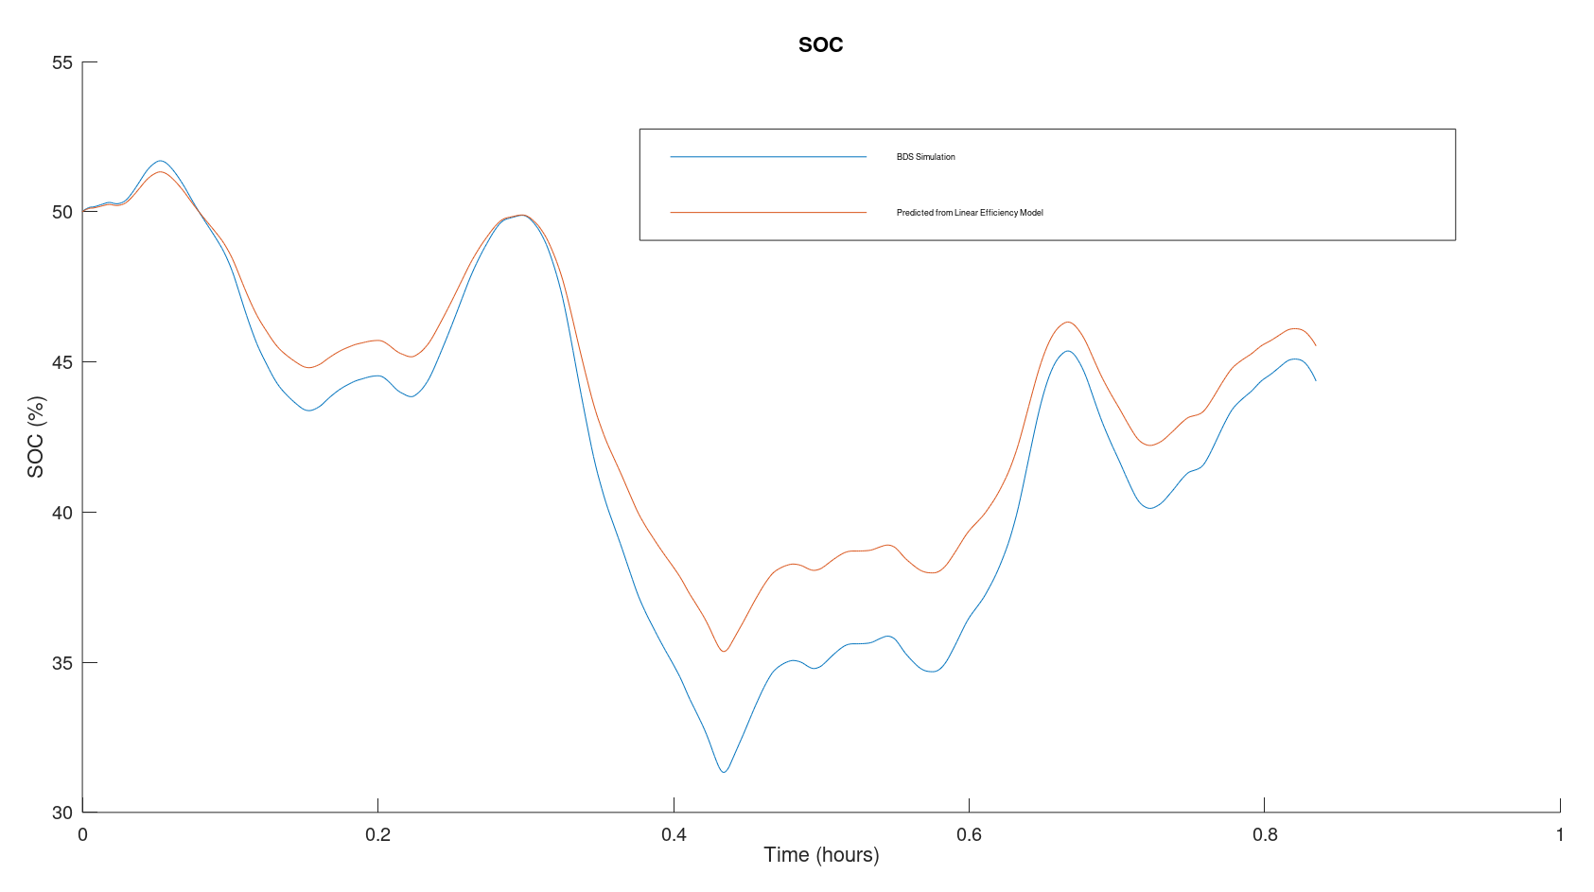
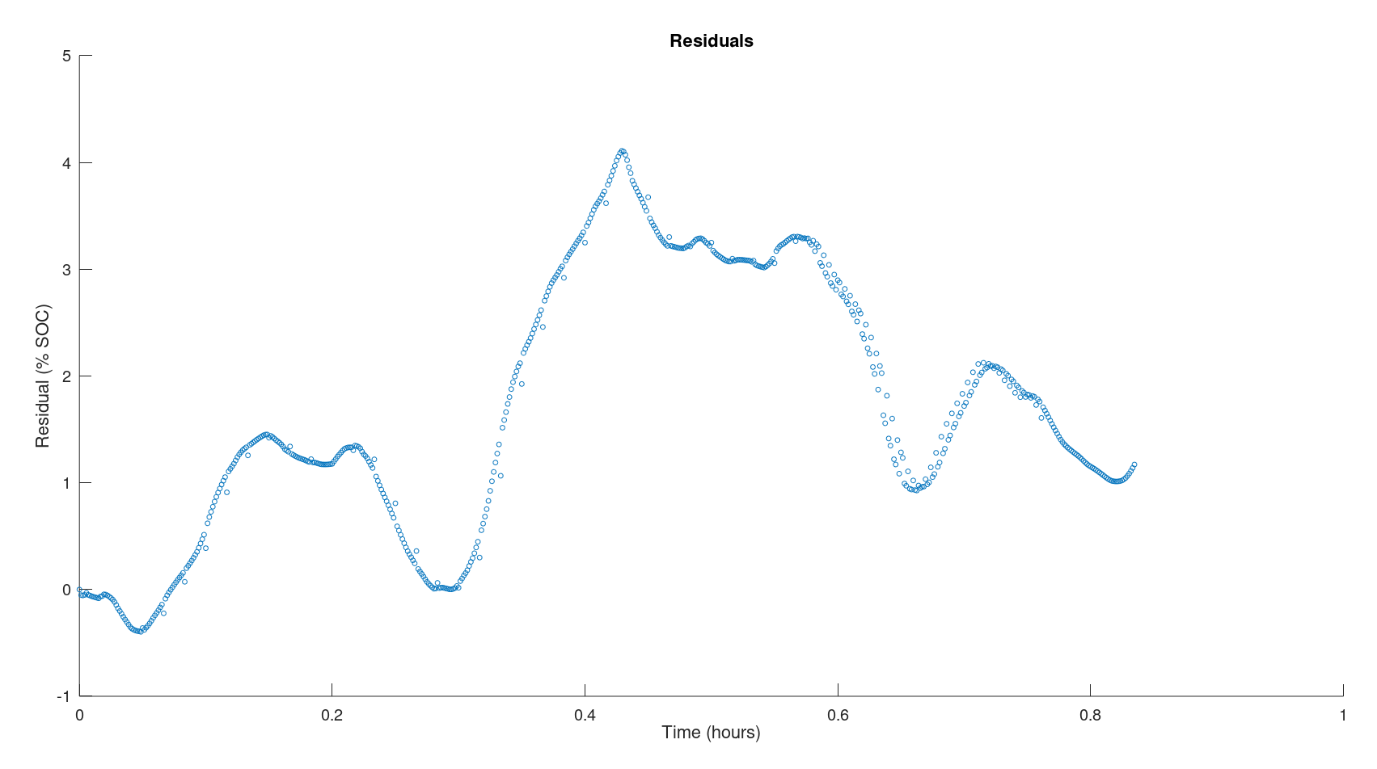

Simple Efficiency Models for Battery Cell State of Charge Estimation CEE 292X Fall 2019 Corey Shono & Timnah Zimet
Motivation
Background
Battery state of charge (SOC) cannot be measured directly in practice, and yet it is important to know in all transportation and grid applications. While complex models of batteries and equivalent circuit models (ECMs) offer more accurate results, approximations that can be applied to real batteries easily are used often. The simplest approximation is a constant efficiency value equal to the ratio of effective charge to input charge.
Key Questions
How accurate is the approximation of a constant efficiency as the coefficient of charge or discharge current?
Are other simple mathematical models of efficiency able to better approximate the battery SOC?
Results
Conclusions & Future Work
Summarize key takeaways
Identify key next steps
Calculating efficiency terms
Input cycle:
1A charge and discharge rates at 1 hour each
Results:
Charge efficiency: 0.9889
Discharge efficiency: 0.9988
(or 1.001178 in SOC equation)
Evaluating accuracy: compare BDS to linear efficiency SOC prediction
Methodology
Describe succinctly your approach
Describe inputs/outputs/data/components/tools (e.g. BDS) utilized
Contrast with existing literature/state of the art
As a “ground truth” we use the simulation results of the BDS (battery design studio) default NiMH cell ECM. We then compare the results of this to the results using a simple mathematical model for SOC with constant efficiency:
$$Q_{t}=Q_{t−1}+ γ_{c}c_{t}∆t−γ_{d}d_{t}∆t$$
Where Q is the state of charge, c is the charge rate, d is the discharge rate, ϒ are the charge and discharge efficiencies, and Δt is the time step.
In order to calculate the efficiencies, we use a pulse charge and discharge cycle, so that c and d are each constant for many time steps in a row.
To evaluate the accuracy, we then use these efficiencies to predict the SOC with realistic charge and discharge cycles, and compare to the BDS results with the same cycles.
Input cycle: daily peak shifting
Results: Max residual 0.078% SOC, final residual 0.055% SOC
Acknowledgements
Thomas Navidi
Input cycle: regulation D signal
Results: Max residual -0.16% SOC, final residual -0.065% SOC
Bibliography
That one paper with piecewise efficiency model, and the sources for regulation / daily peak shifting data
Put plots of input cycles here?
Input cycle: less smooth regulation D signal
Results: Max residual -0.16% SOC, final residual -0.065% SOC

